Slide 1



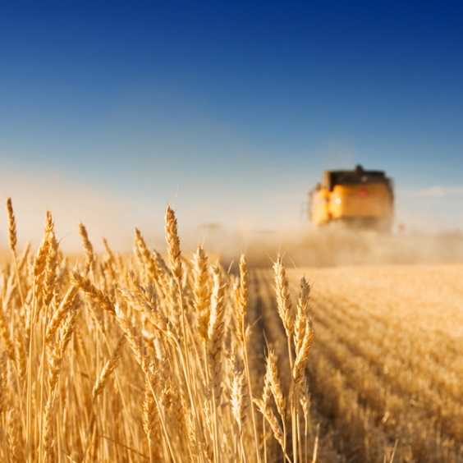
Long read genome assembly course
2-day workshop
21/22 November 2024

Slide 2
Aim of the workshop
Learn the basics of genome assemblies
We will go through the entire process
Read quality
Genome assembly
Comparison & validation
Gain hands-on experience
Discuss and evaluate our findings

Slide 3
General information
Christina Papastolopoulou
MSc, currently doing her PhD in bioinformatics (plant pangenomics)
Sven Warris
PhD in bioinformatics, researcher Applied Bioinformatics
Netherlands Plant Eco-phenotyping Centre
November 21: room B0106 in the Forum building.
November 22: room B0106 in the Forum building

Slide 4
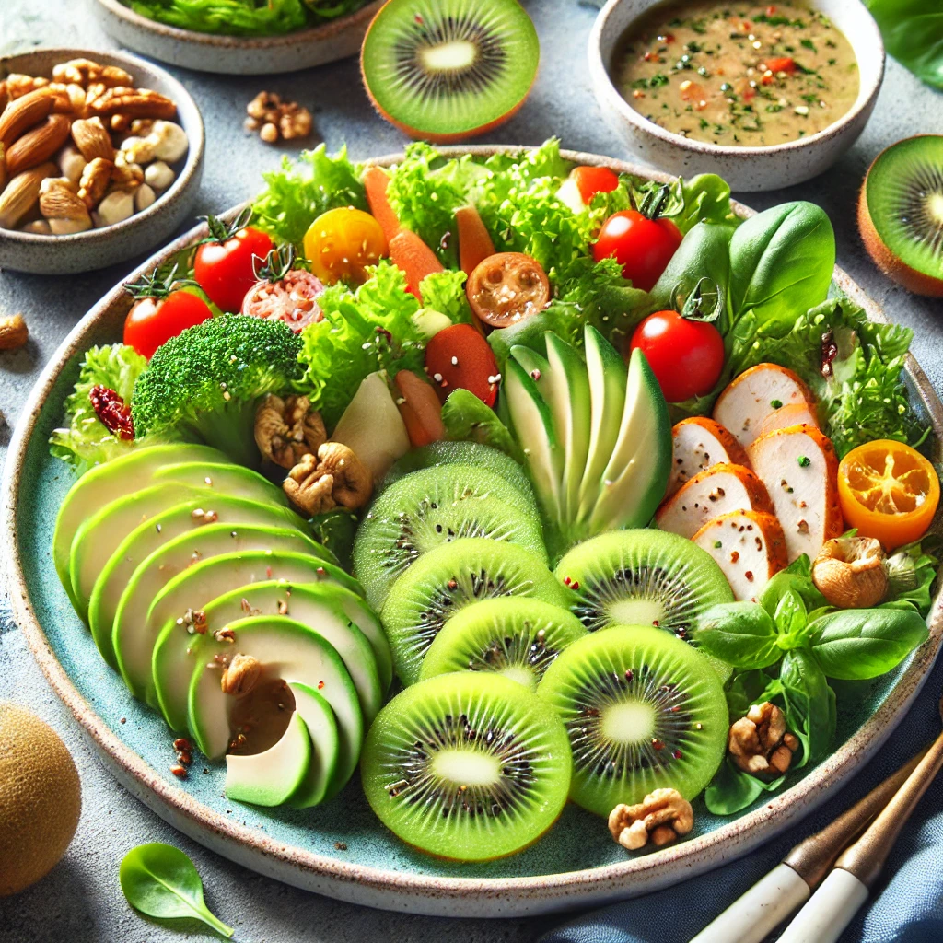
General information
Google docs link in the course materials
Post your results, questions, observations, etc
Be respectful
Coffee, Tea & lunch are provided

Slide 5
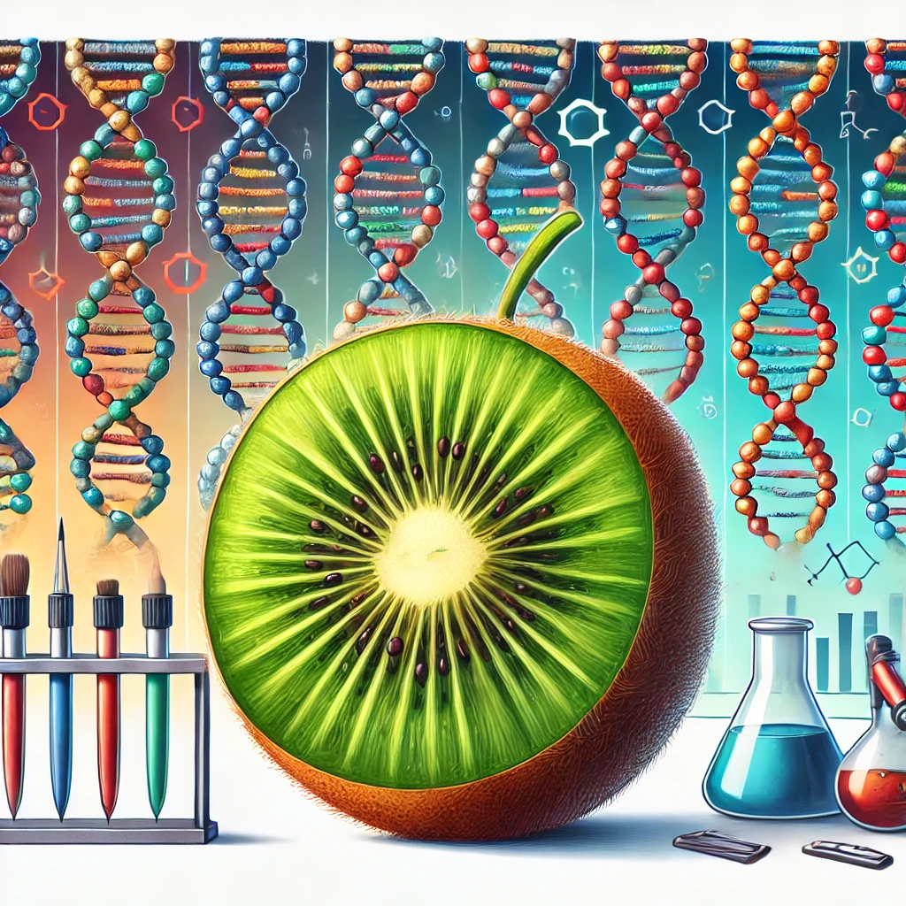
Data & tools
Kiwifruit region of ~2.5Mb
diploid
Mapped PacBio Hifi & Nanopore data & extracted reads
assembly-stats, quast, seqtk, Tablet
Minimap2, mummer 4
Flye assembler
Hifiasm assembler

Slide 6
PacBio Sequel IIe / Revio
Long reads > 50kb
High throughput
Error rate < 10-15%
Proven technology
De novo assembly (but compute intensive)
Structural variant detection (re-sequencing)
Full-length RNA (IsoSeq sequencing)
Amplicon sequencing

Slide 7
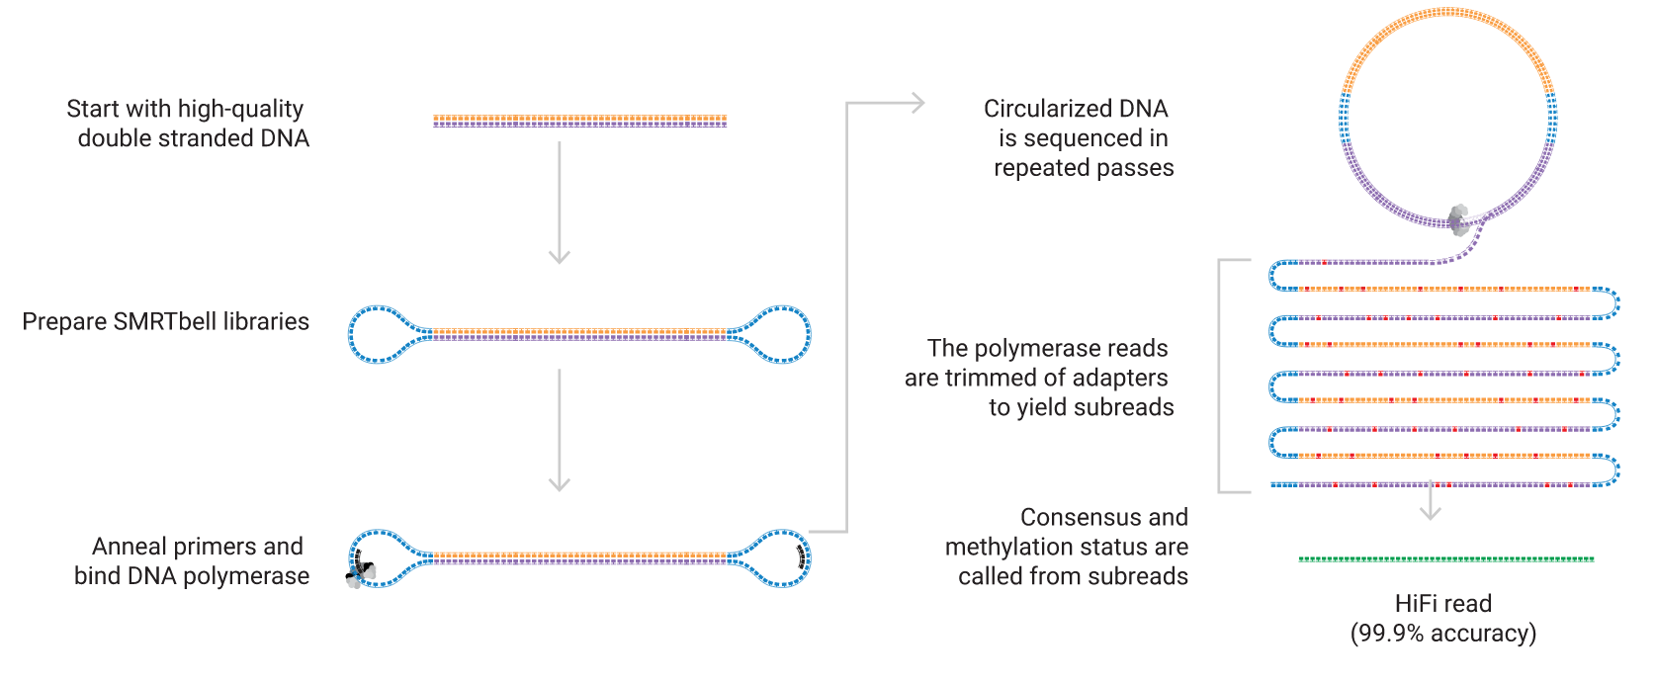
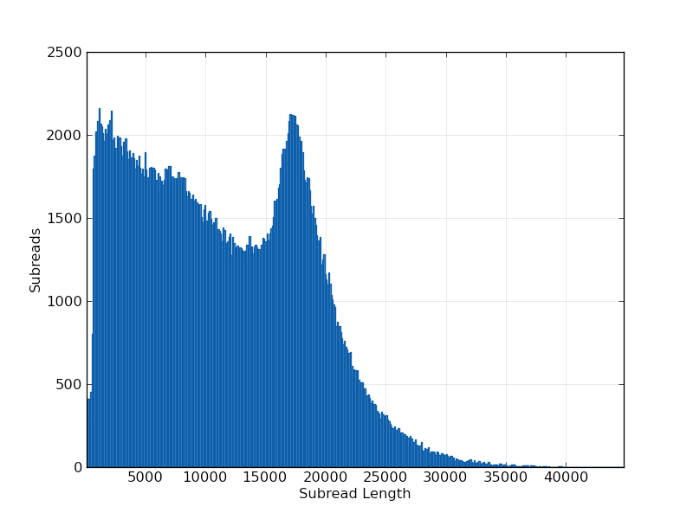
PacBio HiFi

Slide 8
Oxford Nanopore Technologies sequencing
Extremely long reads > 200kb
High throughput
Error rate 5-10%
Low DNA input requirements
Direct sequencing
De novo assembly (but very compute intensive)
Structural variant detection
Unstable in data production

Slide 9
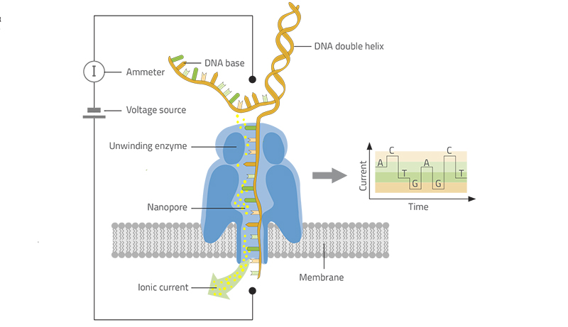
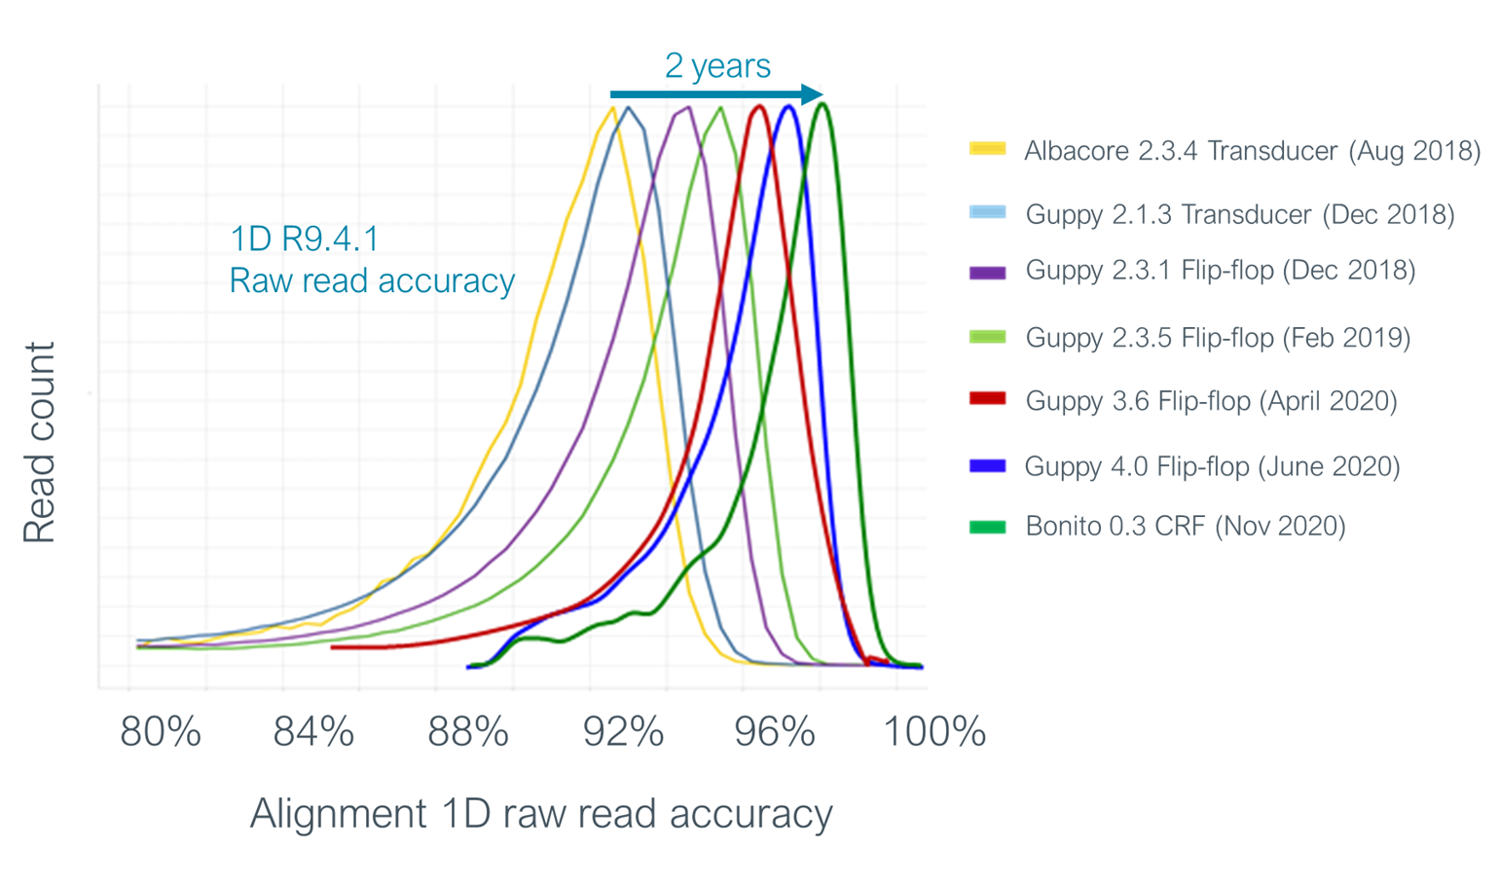
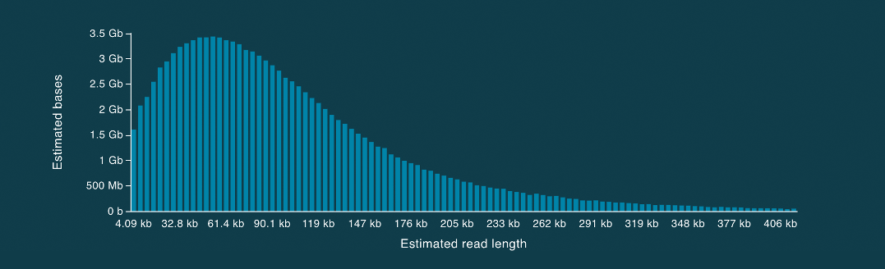
Oxford Nanopore Technologies sequencing

Slide 10
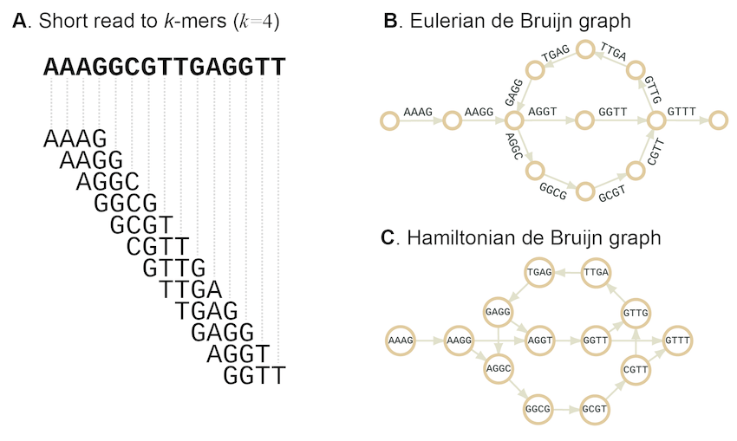
Genome assembly process: de Bruijn graph

Slide 11
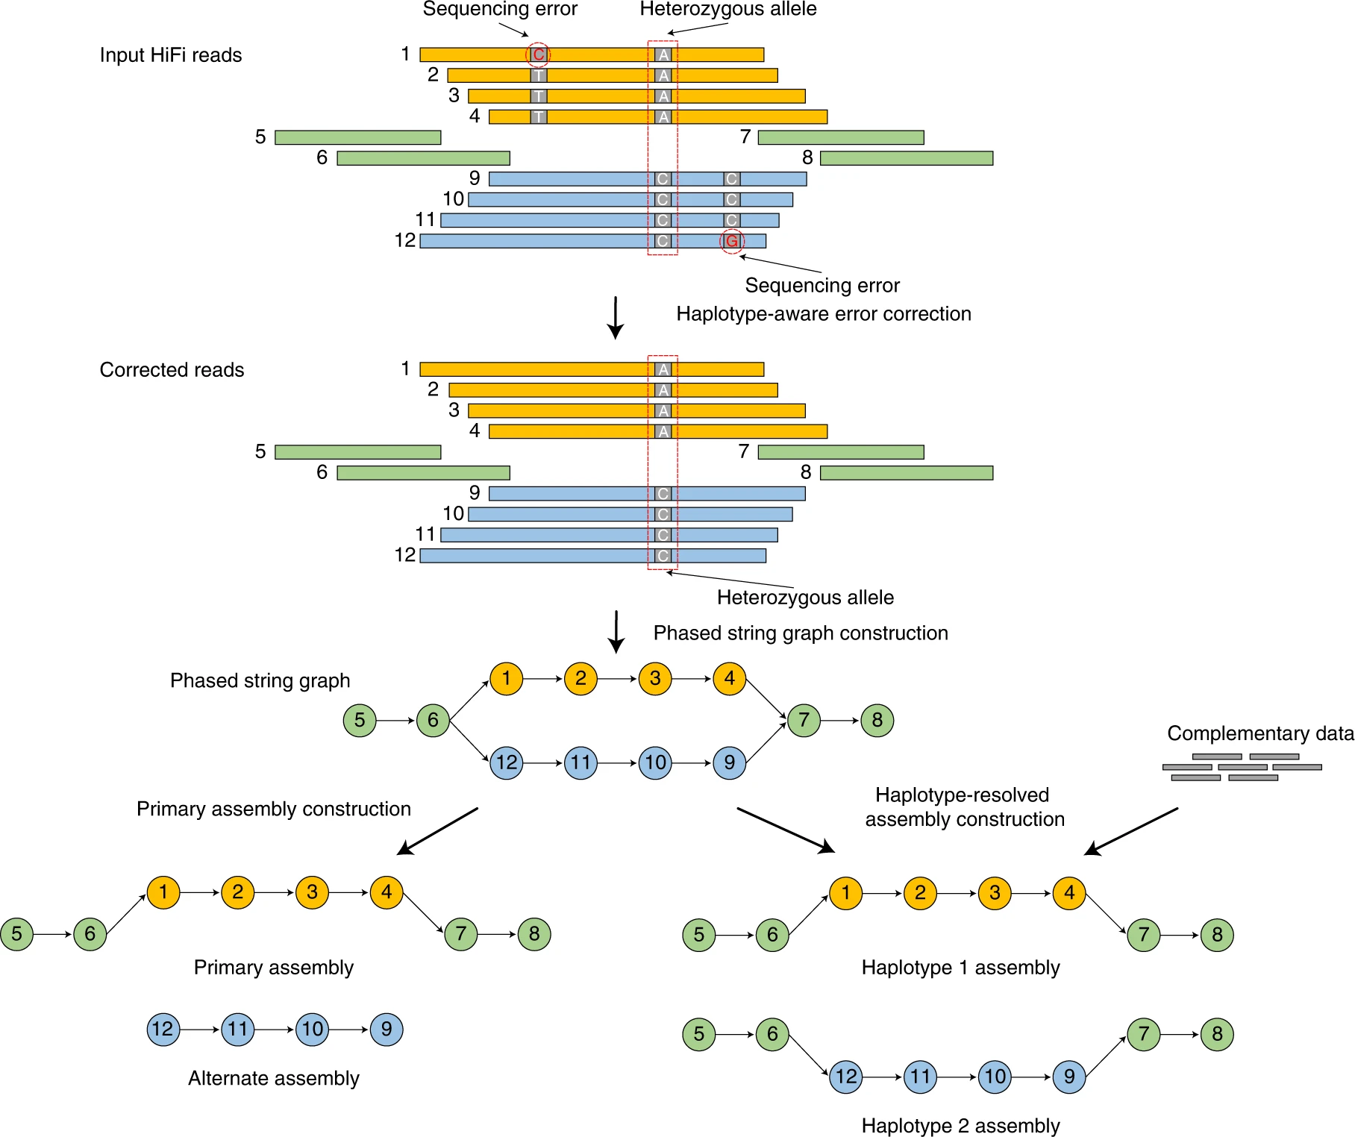
Hifiasm

Slide 12
ChatGPT & other LLMs
The use of Large Language models are highly encouraged
Creating experiment flow
Explaining concept
Tool selection and explaination of CLI
Debugging and error message parsing
Can you explain the difference between pacbio raw reads, subreads and hifi reads? I’m completely new to these concepts
I have a set of pacbio reads which I need to map to my large genome. Which tool would you recommend?

Slide 13

Let’s start

